Slide 1
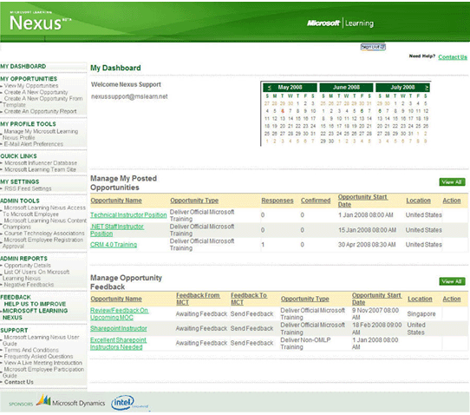
Nexus Sharepoint Extranet
The Challenge
Microsoft off-shored the development of their external learning portal, with the goal of creating a central location for employees to create opportunities that MCTS and CPLSs would be selected from. The project had large architectural issues and was going to take 3 months longer than its original deployment date.
What We Did
Affirma completed an architectural and business review of the project.
Based on the findings, Affirma reported results and recommendations to Microsoft.<br><br>
We then deployed a team to resolve architectural issues to reach a phase I deployment.
Results
Microsoft Learning Nexus was launched on time. Affirma leveraged SharePoint and web technologies to streamline this process and maximize efficiency. Thousands of opportunities are now managed from one centralized location.

